Slide 1
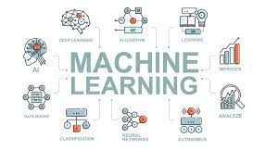

PROJECT PRESENTATION
ON
Automatic Attendance System Based On Face Detection And Recognition
PRESENTED BY :
SHIV KUMAR(8521245)
B.TECH CSE(AIML)

Slide 2
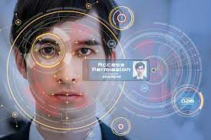
CONTENTS :-
1. Introduction
2. Algorithm ( flow chart )
3. Functional Block Diagram
4. Train faces
5. Face detection
6. How do we create database
7. Mark Attendance
8. Source code
9. Outputs
10. Conclusion
11. Future Work

Slide 3


1.INTRODUCTION :-
Traditionally attendance is marked manually by teachers and they must make sure correct attendance is marked for respective student.
This whole process wastes some of lecture time and part of correct information is missed due to fraudulent and proxy cases.

Slide 4
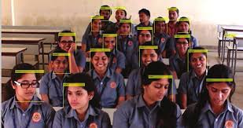
In order to determine classroom attendance, face detection and face recognition are performed. Face detection is used to determine the location of the faces in the classroom image and extract sub images for each face. Then, in face recognition, the face images detected will be compared with the data base consisting of images of students in the class, and attendance will be recorded accordingly.

Slide 5




1.2 SIGNIFICANCE :-
1-Automated
3-Effective
2- Keep extra time

Slide 6
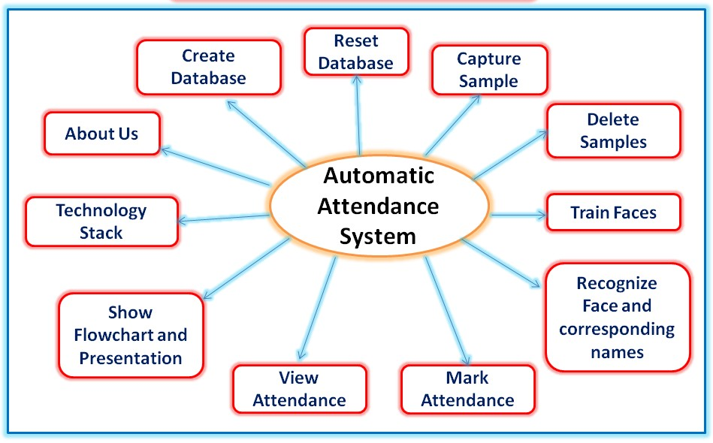
1.3 MODULES :-

Slide 7
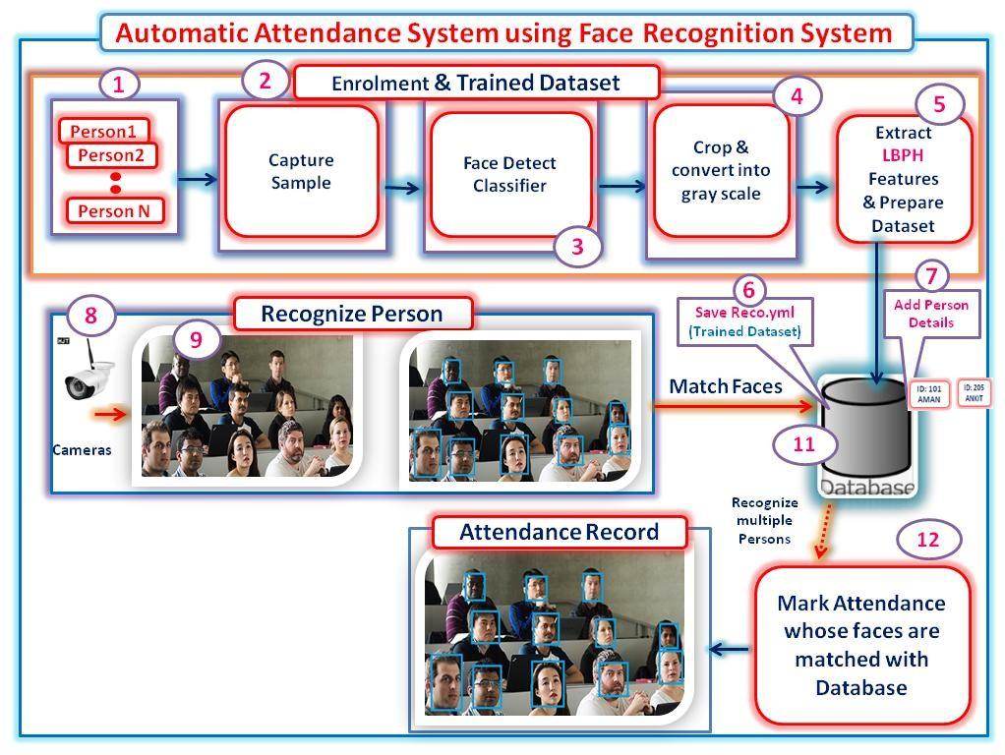
2 Flow chart :-

Slide 8
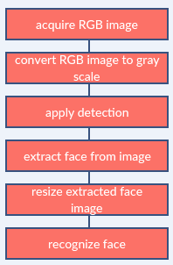
Image processing :-

Slide 9
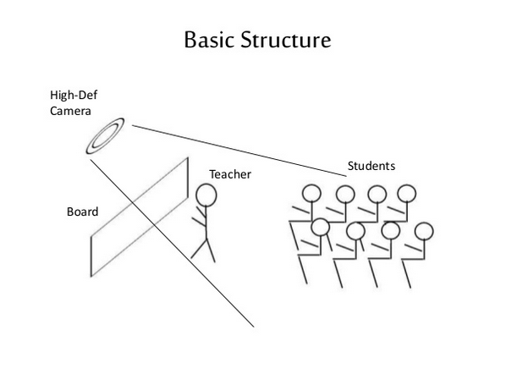

Slide 10
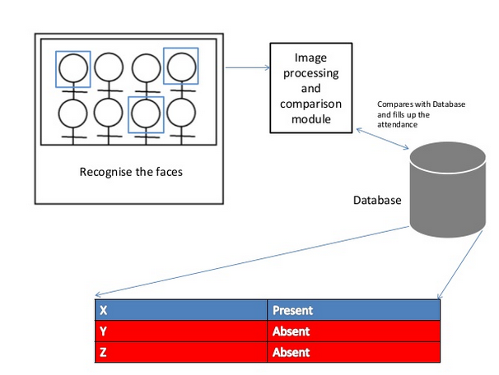

Slide 11
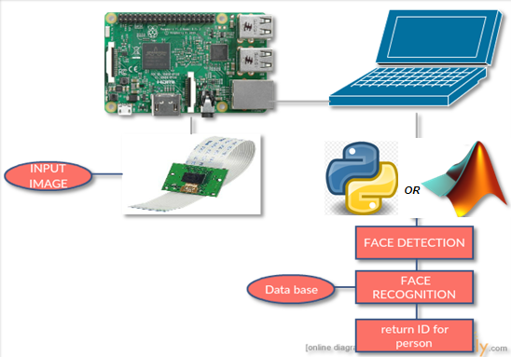
3. Functional Block Diagram :-
The whole system should consist of

Slide 12
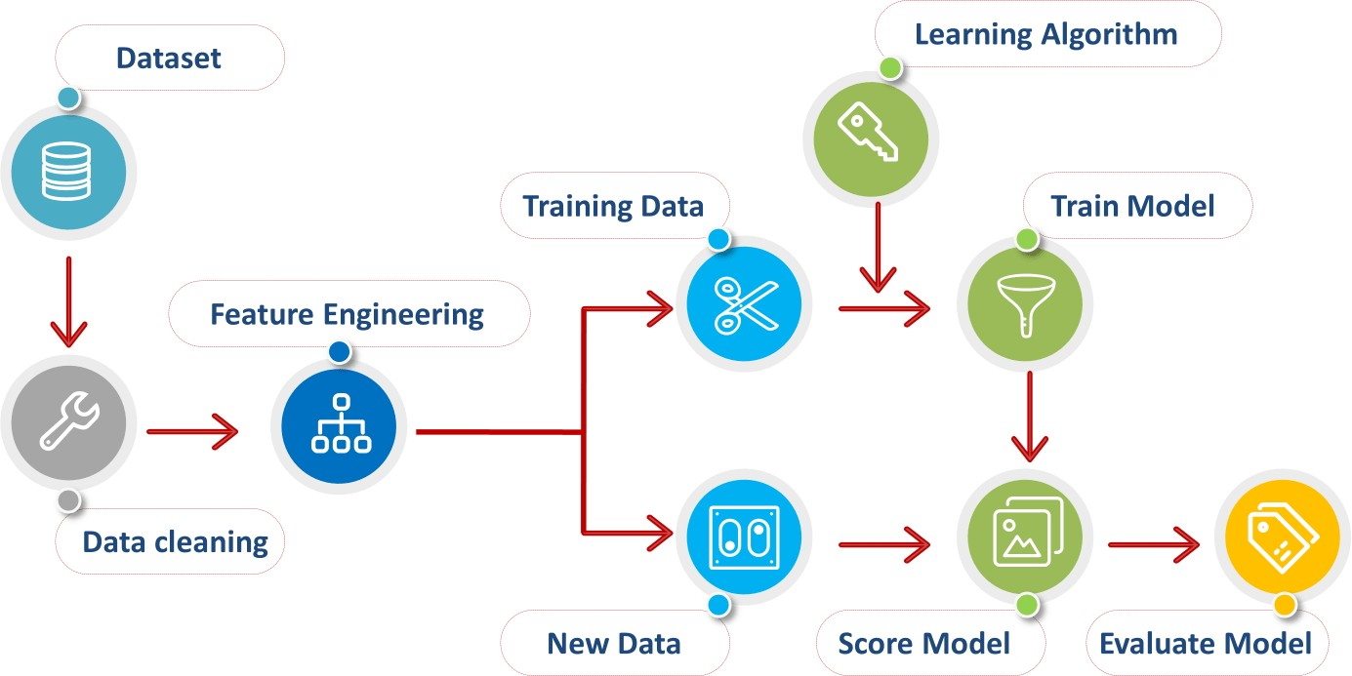
4. TRAIN FACES:-
After enrolling i.e. taking samples of various students; we train the system for those student‟s faces. So that, when the students mark their respective attendance; our Automatic Attendance Management System recognizes that person.

Slide 13
5.FACE DETECTION:-
Face detection is a computer technology used to identify human faces in digital images by determining the location of the faces in the image and extract sub images for each face.
Harrcascade algorithm will be implemented to recognize face and non-face patterns and enable us to identify locations of the faces in the image.

Slide 14
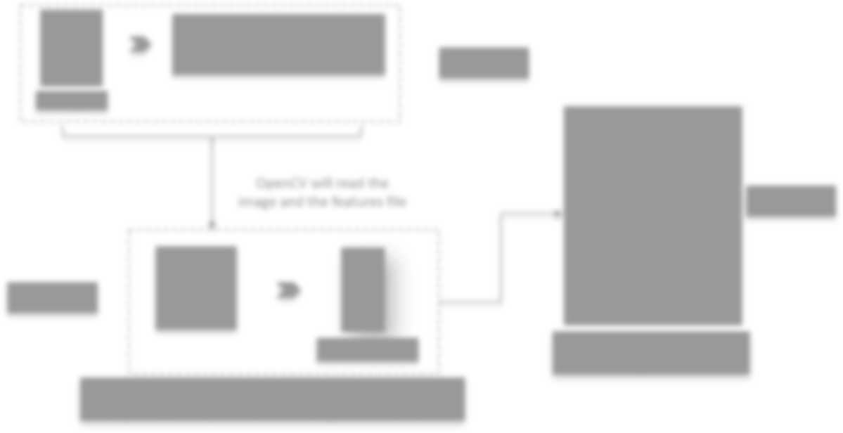
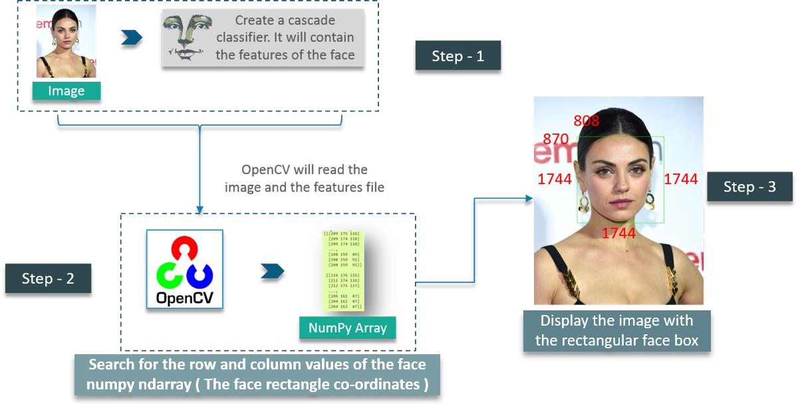

Slide 15
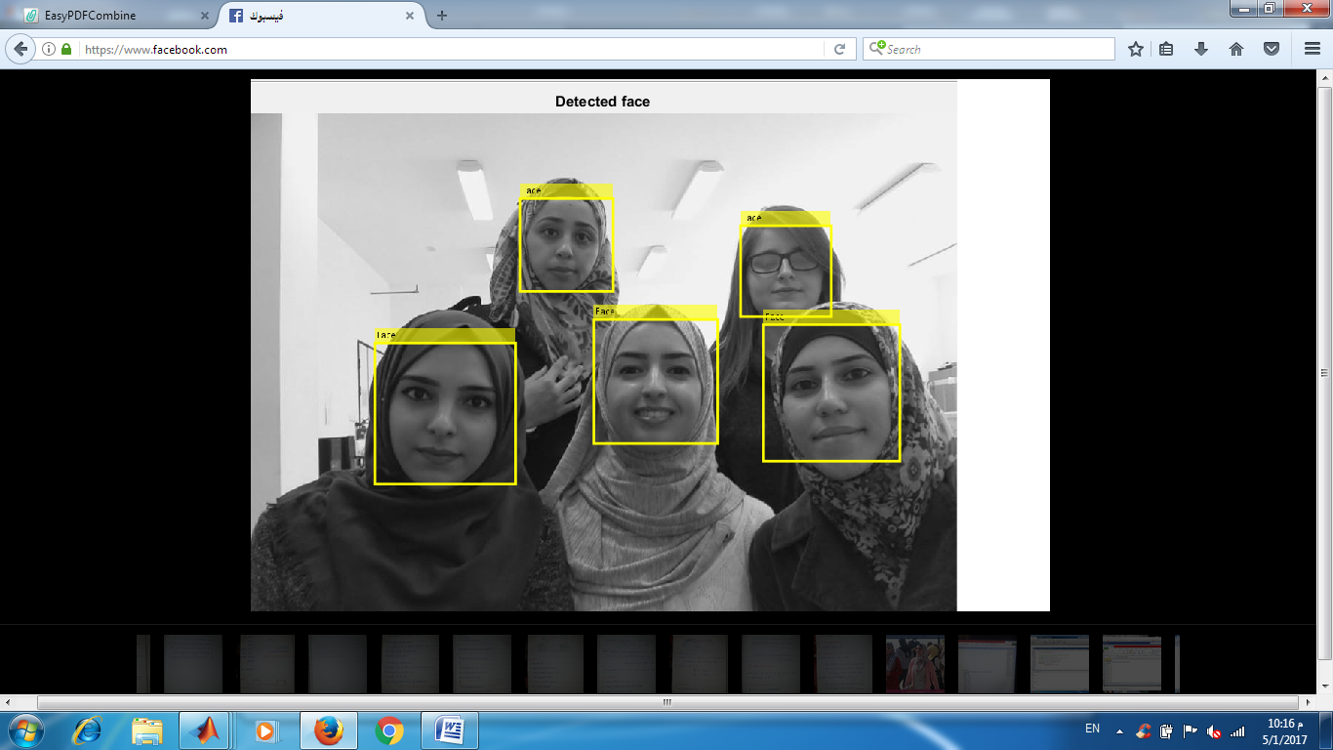
EXAMPLE:-

Slide 16
6. HOW DO WE CREATE DATABASE:-
Database is the collection of face images and extracted features. And the database includes names of students & registeration number for each student .
We created a data base for 18 persons, were we took 10 images per person using raspberry pi model 2 cam, these images were taken at different times and with variations in illumination, facial expressions, and facial details.

Slide 17
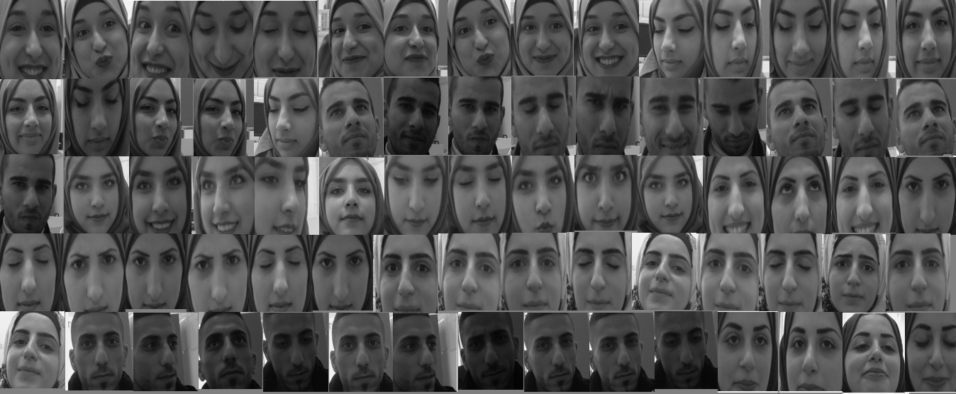
Example of database:-

Slide 18
7. MARK ATTENDENCE:-
Here mainly, after recognition of any student‟s face; it marks attendance of that particular student in the Database. The attendance is marked by student‟s Name, Roll Number and Timestamp. This is done in a CSV file. Thus, we can maintain records of all the users as per the date and time so as to ensure the lecture or time of entry of a particular person. This file can be provided with further restrictions, such that, only admin can access it. So as to make it secure and make further changes (if any).

Slide 19
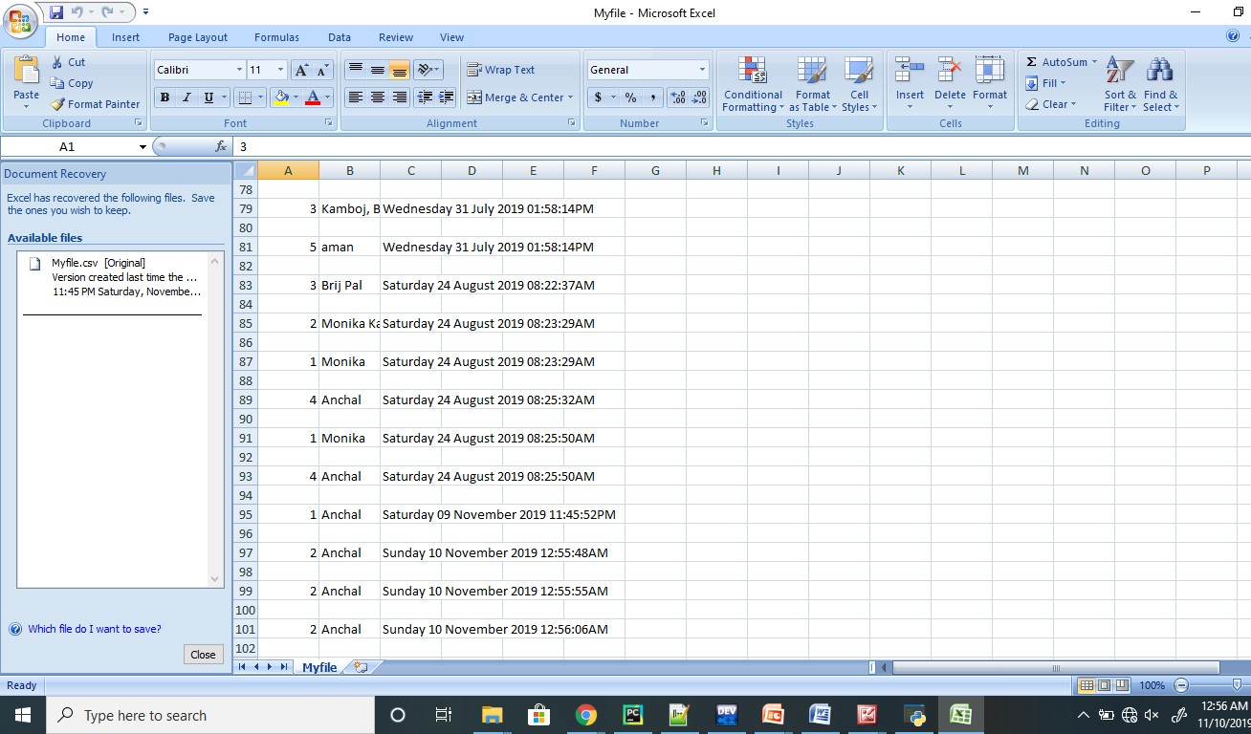

Slide 20
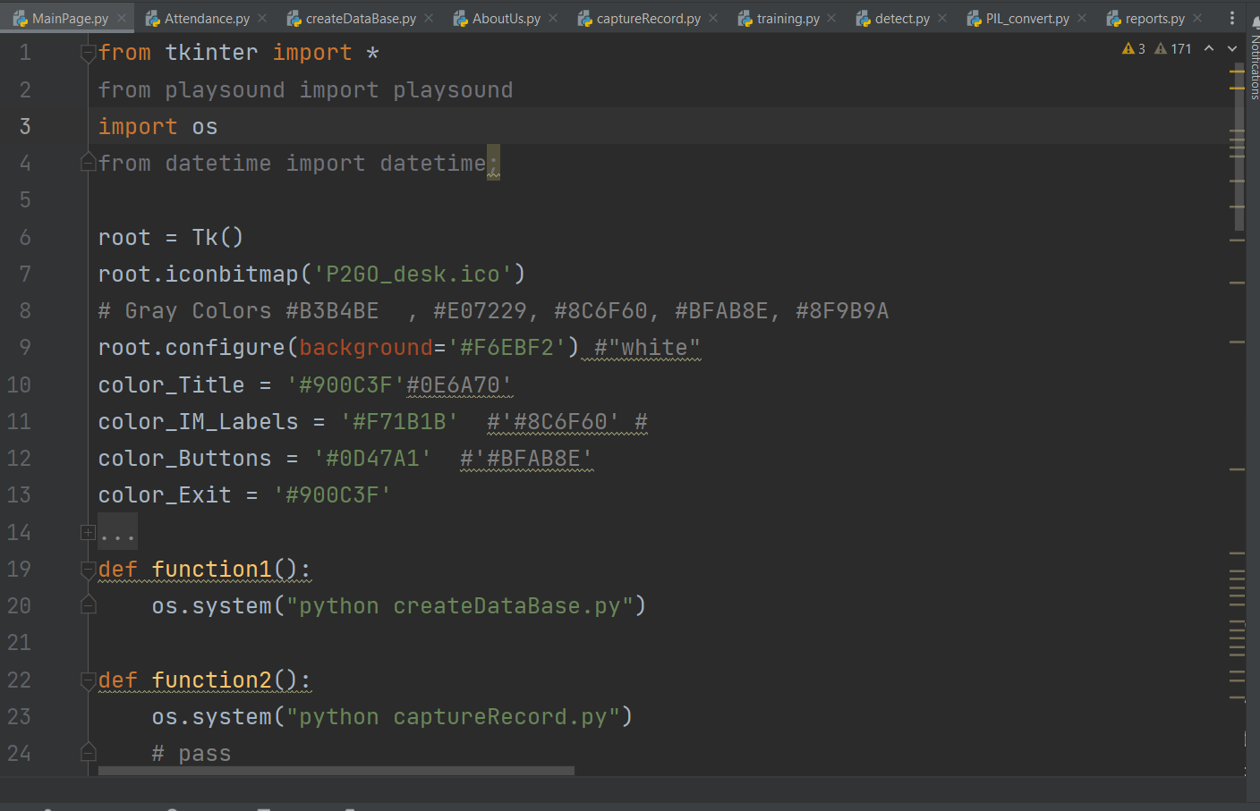
MAIN PAGE
8. SOURCE CODE :-

Slide 21
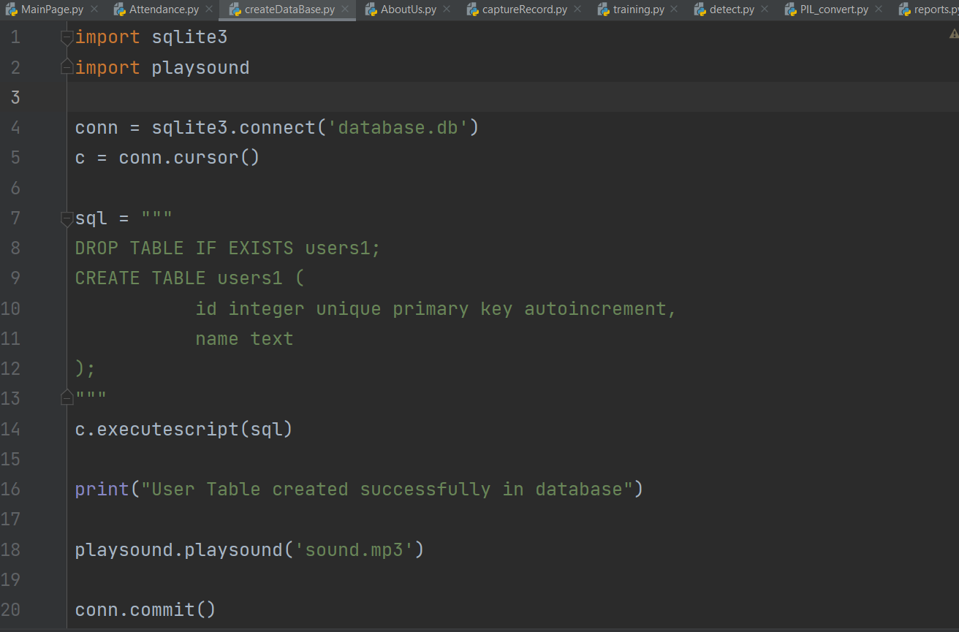
CREATE DATA BASE

Slide 22
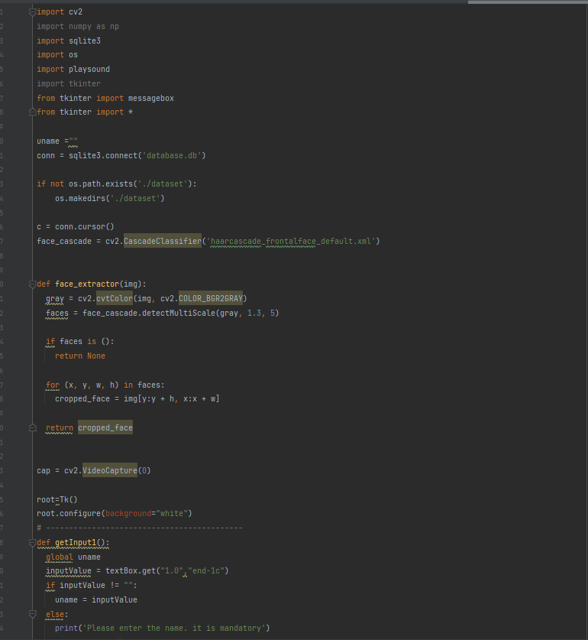
CAPTURE IMAGES

Slide 23
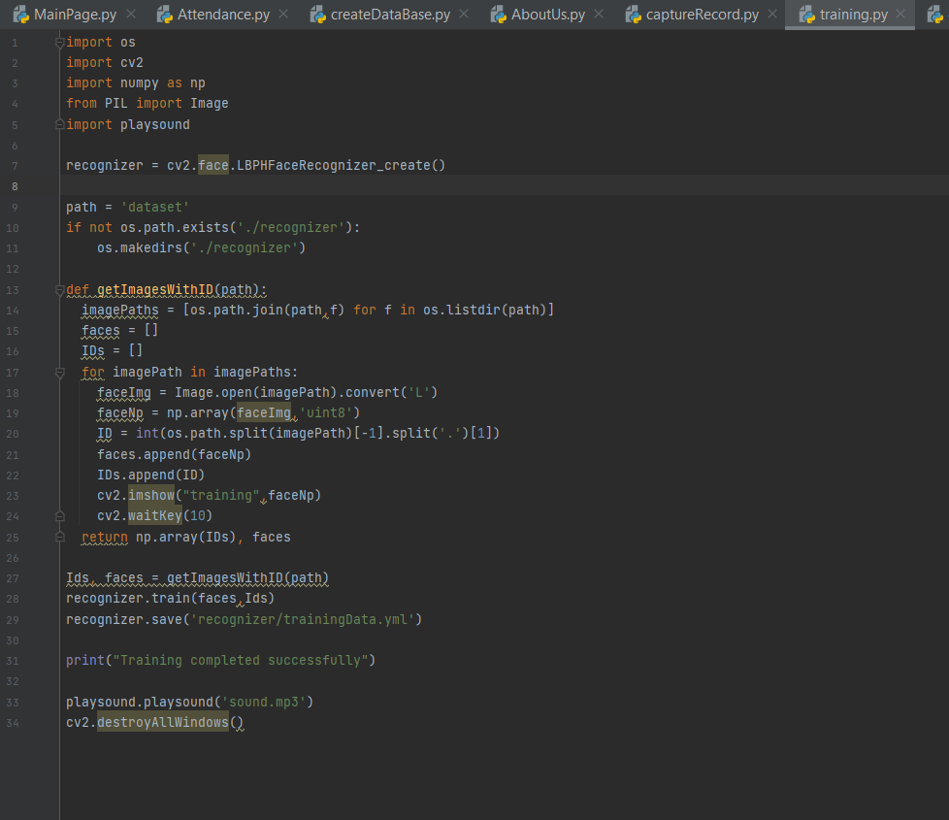
TRAINING

Slide 24
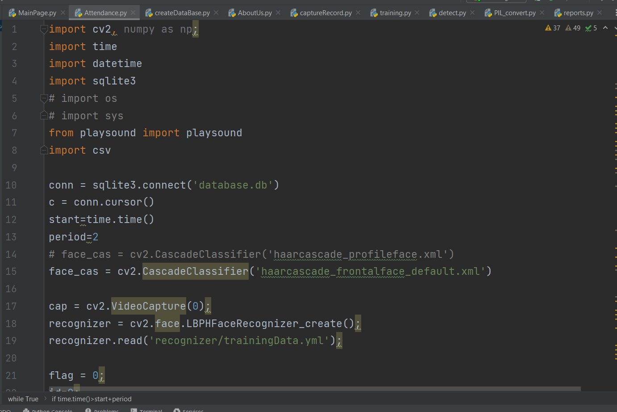
ATTENDENCE

Slide 25
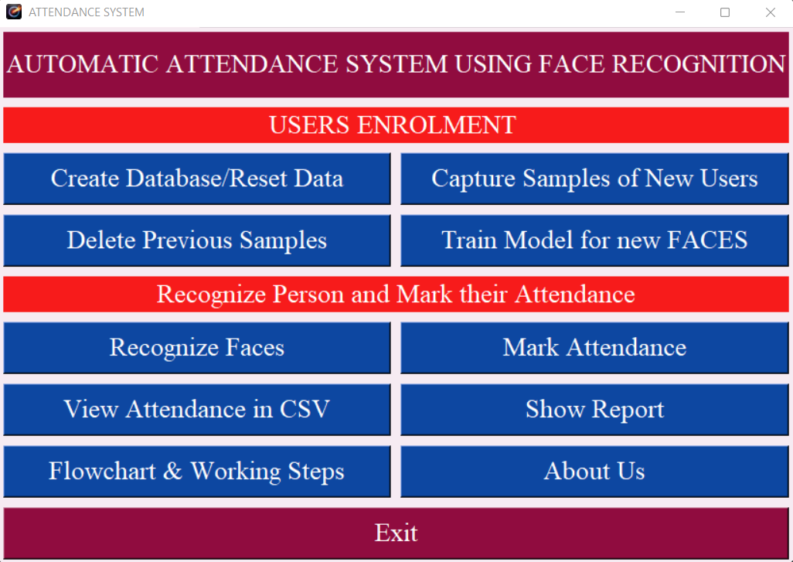
9. OUTPUT :-

Slide 26
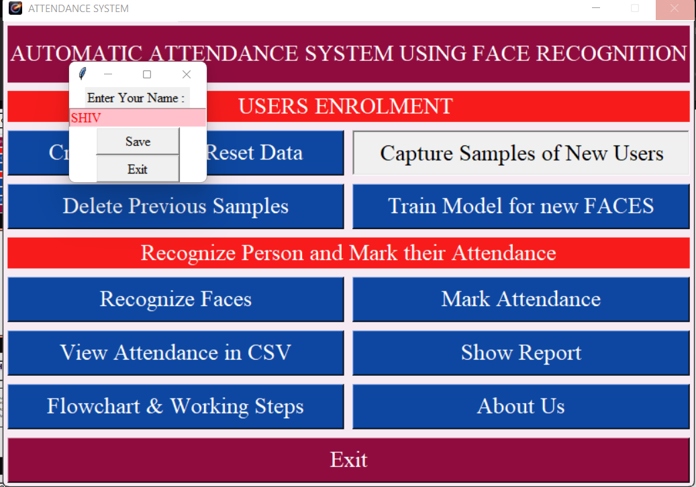

Slide 27
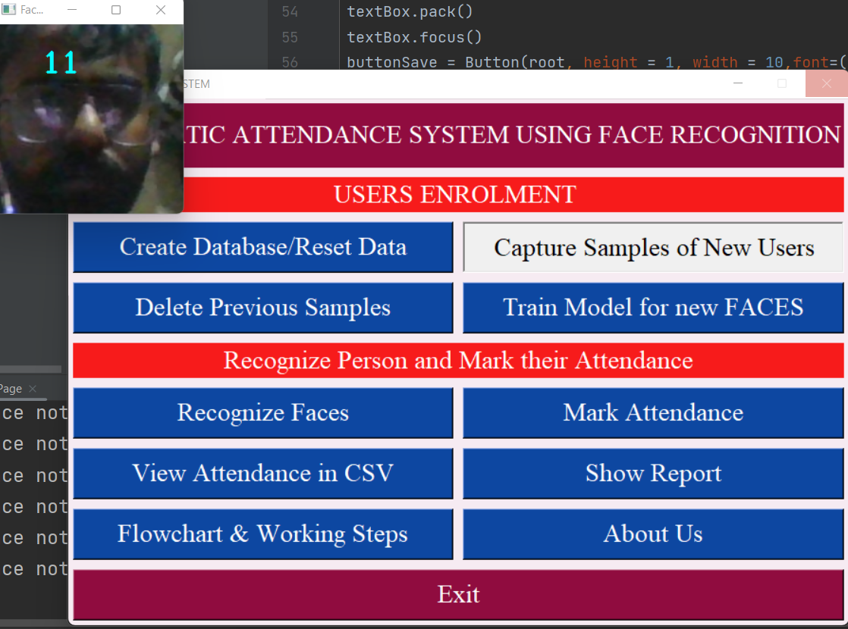

Slide 28
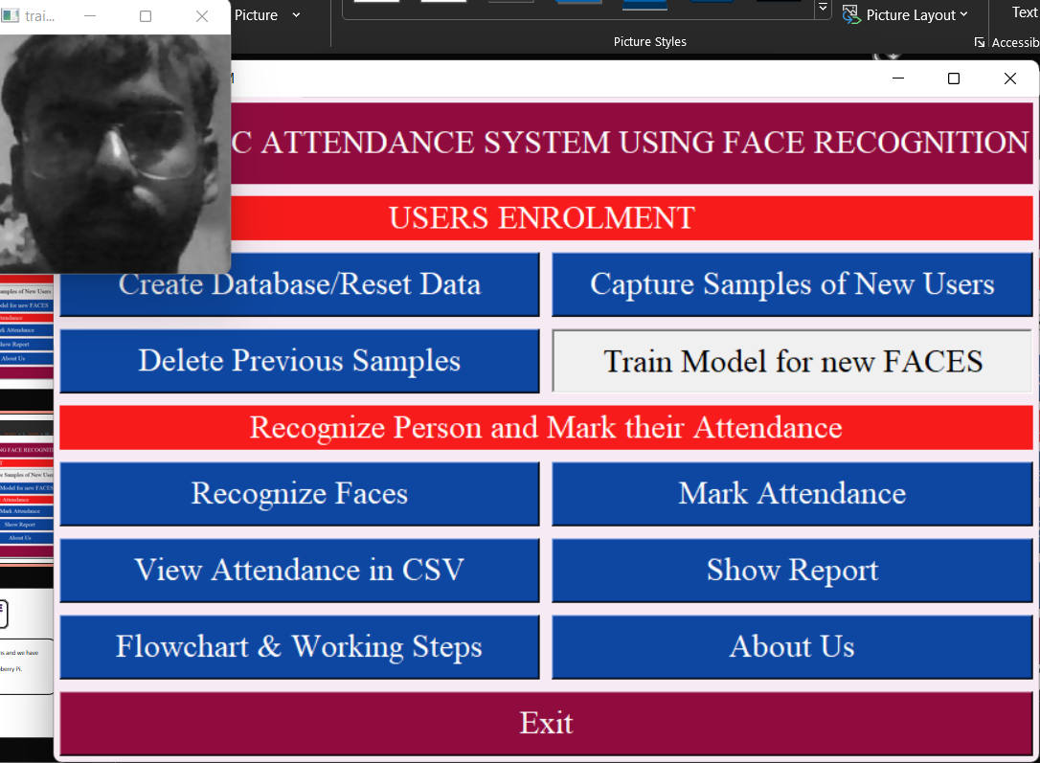

Slide 29
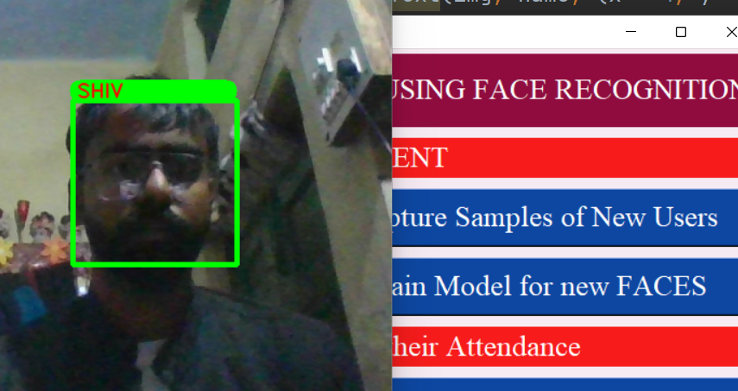

Slide 30
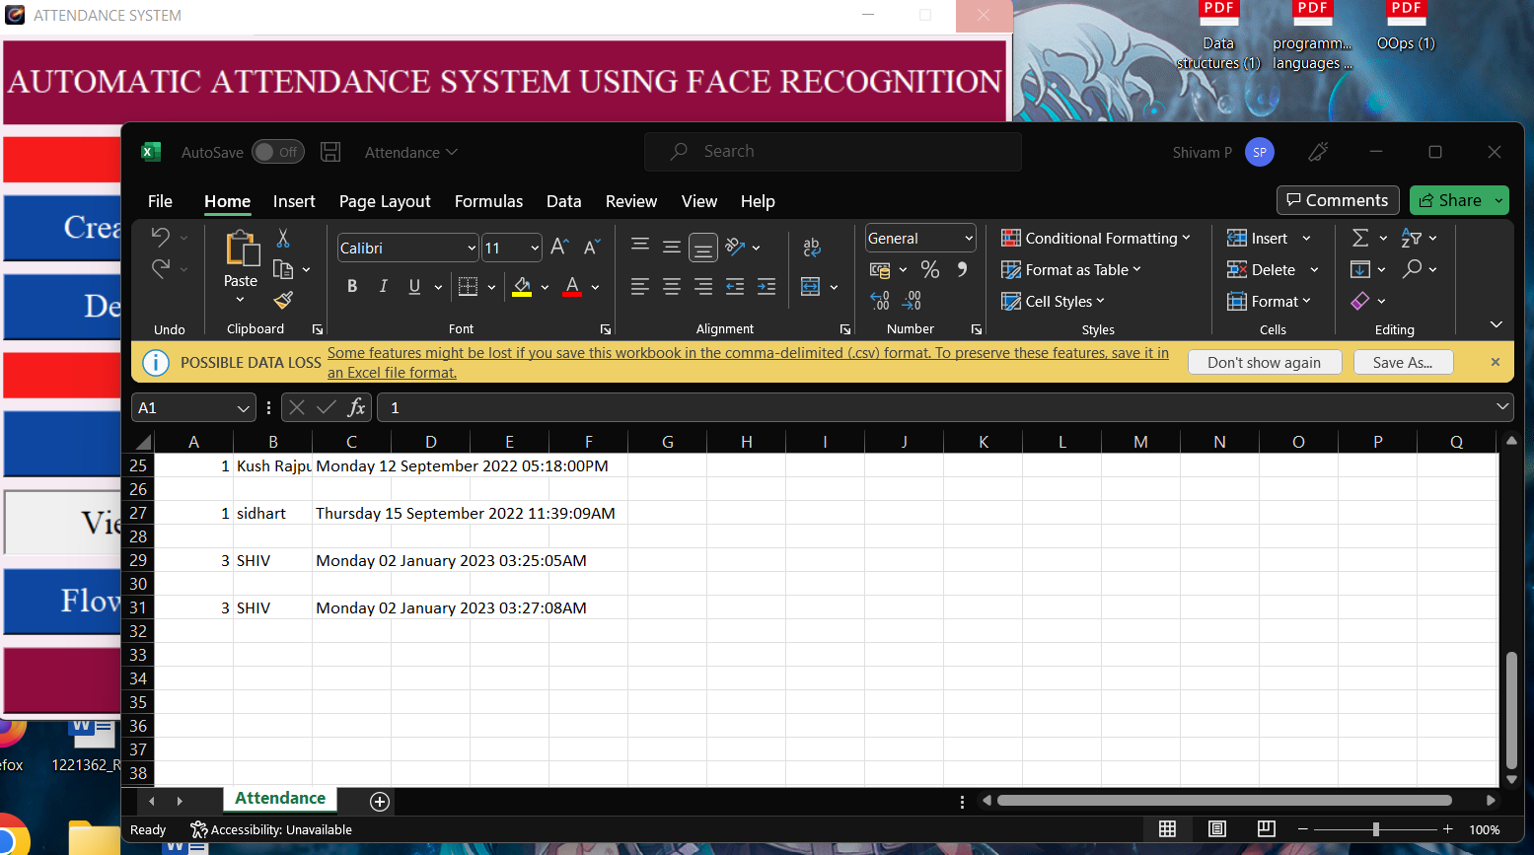

Slide 31
10. Conclusion:-
From our experiment, we noticed the face recognition was sensitive to face background, light, and head orientations. This technique described the accurate and efficient method of automatic attendance in the classroom which could replace the traditional method. An automatic attendance has many advantages, most of the existing systems are time consuming and require semi manual interference from lecturers, our system seeks to solve these issues by using face recognition in the process to save the time and labor. And No need for installing complex hardware for taking the attendance in classroom, all we need is a camera and laptop. We used algorithms that can detect and recognize faces in the image.

Slide 32
11. FUTURE WORK:-
Automatic attendance system can be improved by increasing the number of features which can be extracted to increase accuracy of face recognition. Once the software is developed and tested properly, it could be improved to cover full institutions such as the faculty of engineering.

Slide 33


